Slide 1
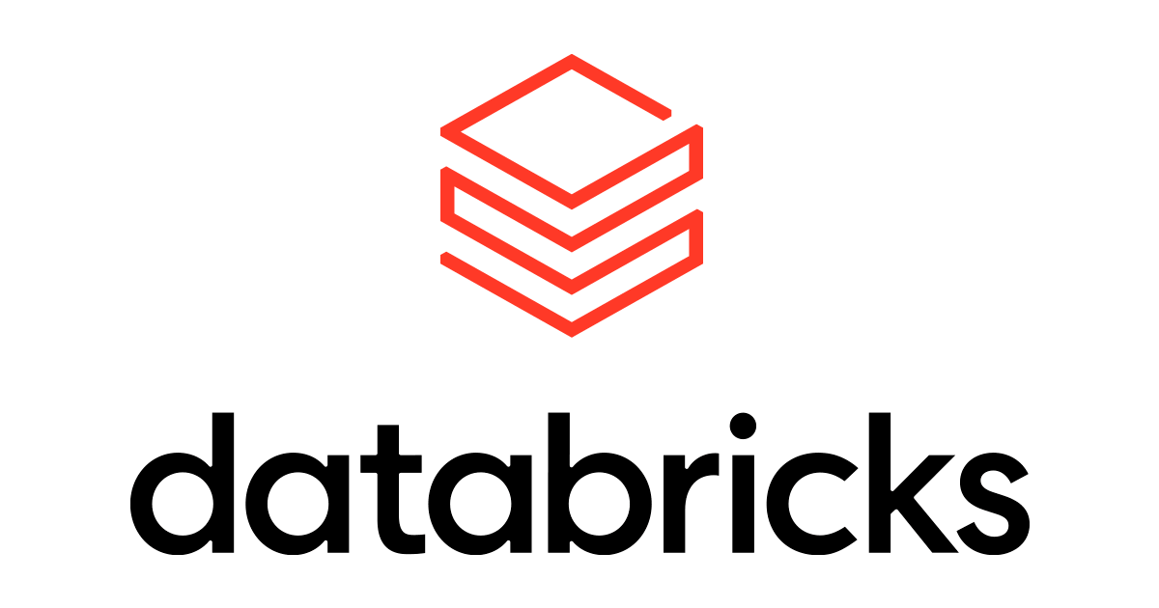
Generative AI
(with Azure Databricks)

Slide 2
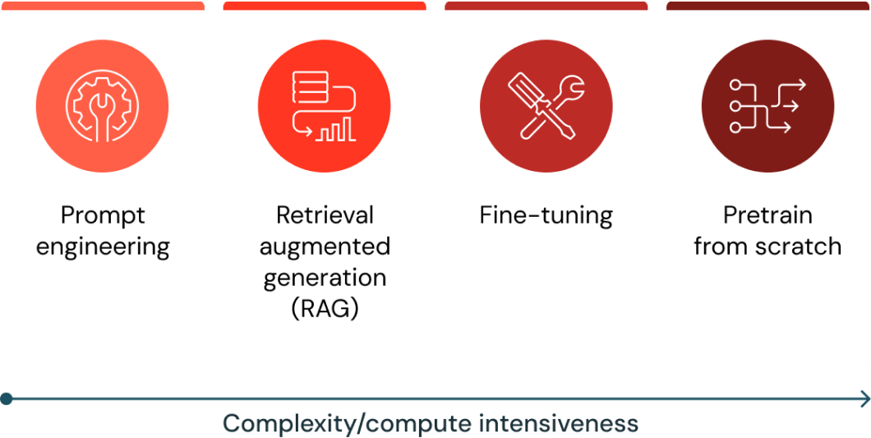
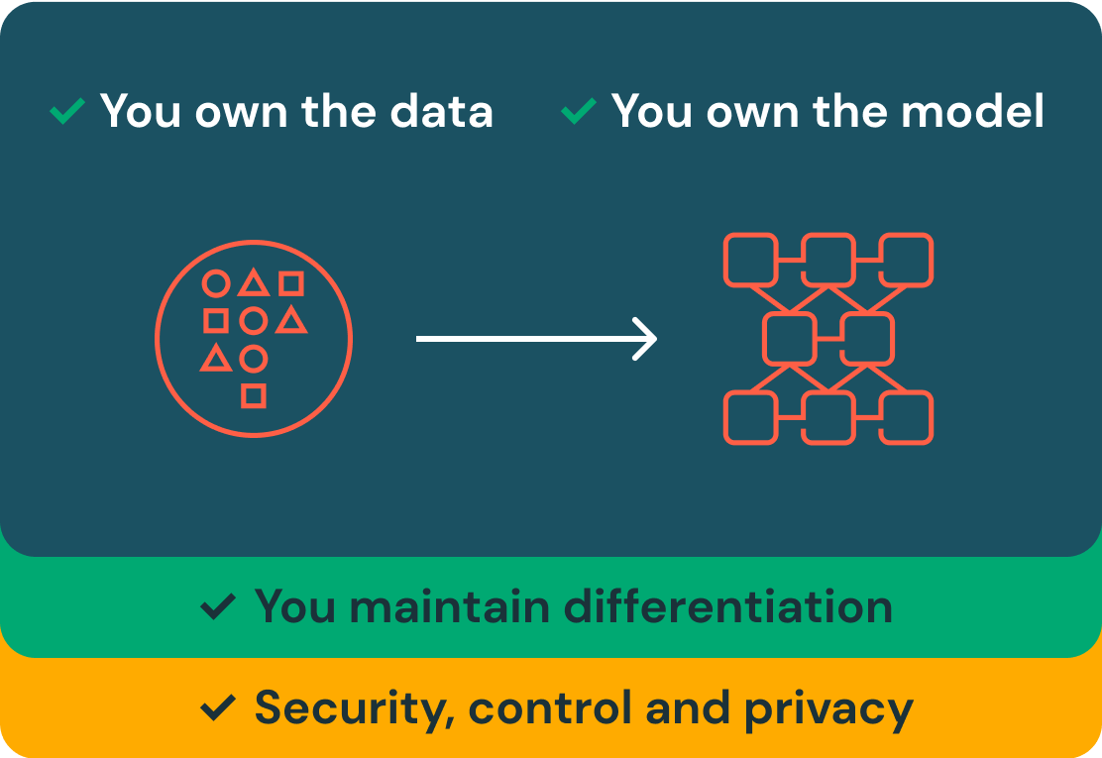
GenAI on Azure Databricks
Mosaic AI Agent Framework comprises a set of tools on Databricks designed to help developers build, deploy, and evaluate production-quality agents like Retrieval Augmented Generation (RAG) applications.
You can deploy Foundational Large Language Models in Azure Databricks. Base models, like DBRX Instruct, Meta-Llama-3.1-70B-Instruct, GTE-Large, and Mistral-7B are available for immediate use with pay-per-token pricing, and workloads that require performance guarantees, like fine-tuned model variants, can be deployed with provisioned throughput.

Slide 3
